Slide 1
UNIT IV Backtracking
Session – 23

Slide 2
Syllabus
Introduction - NXN Queen's Problem, NXN Queen's Problem, Sum Of Subsets, Graph Coloring, Hamiltonian's Circuit, Travelling Salesman Problem, Generating Permutation

Slide 3
Backtracking
Recursion is the key in backtracking programming.
We start with one possible move out of many available moves and try to solve the problem
if we are able to solve the problem with the selected move then we will print the solution
else we will backtrack and select some other move and try to solve it.
If none if the moves work out, we will claim that there is no solution for the problem.

Slide 4
Generalized Algorithm:
Pick a starting point.
while(Problem is not solved)
For each path from the starting point.
check if selected path is safe, if yes select it
and make recursive call to rest of the problem
If recursive calls returns true, then return true.
else undo the current move and return false.
End For
If none of the move works out, return false,
NO SOLUTON.

Slide 5
N*N QUEEN’S PROBLEM
Consider n by n chess board, and the problem of placing n queens on the board without the queens threatening one another.

Slide 6
The solution space is {1, 2, 3, , n}^{n}. The backtracking algorithm may record the columns where the different queens are positioned.
Trying all vectors (p1, ..., pn) implies cases. Noticing that all the queens must reside in different columns reduces the number of cases to n!.

Slide 7
4*4 queen
Algorithm: - Start with one queen at the first column first row
Continue with second queen from the second column first row
Go up until find a permissible situation
Continue with next queen

Slide 8
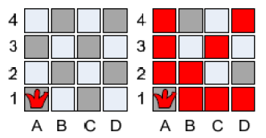
We place the first queen on A1:

Slide 9
Note the positions which Q1 is attacking. So the next queen Q2 has to options: B3 or B4. We choose the first one B3

Slide 10
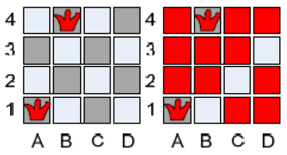

Slide 11
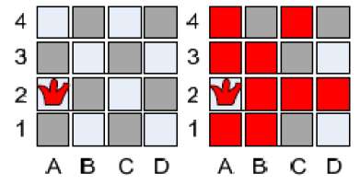
We have started from Q1 so we will continue upward and placing the queen at A2

Slide 12
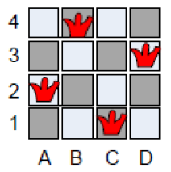

Slide 13
To find this solution we had to perform two backtracks. In order to find all solutions we use as you can guess – backtrack!
Start again in reverse order we try to place Q4 somewhere up, which is not possible. We backtrack to Q3 and try to find admissible place different from C1.
Again we need to backtrack. Q2 has no other choice and finally we reach Q1. We place Q1 on A3:

Slide 14
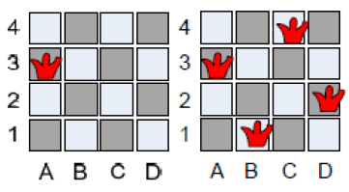
Another solution

Slide 15
Algorithm place (k,I)
//return true if a queen can be placed in k th row and I th column. otherwise it returns false.
//X[] is a global array whose first k-1 values have been set. Abs® returns the absolute value of r.
For j=1 to k-1 do
If ((X [j]=I) Or (abs (X [j]-I)=Abs (j-k)))
//two in same column or diagonal
Then return false;
Return true;

Slide 16
Algorithm Nqueen (k,n)
//using backtracking it prints all possible positions of n queens in „n*n‟ chessboard. So
//that they are non-tracking.
For I=1 to n do
If place (k,I) then
X [k]=I;
If (k=n) then
write (X [1:n]);
Else nqueens(k+1,n) ;

Slide 17
Try this 8*8 queen problem

Slide 18
Check this
Animated Example:
http://www.hbmeyer.de/backtrack/achtdamen/eight.htm#up

Slide 19
Worksheet No. 23 & 24

